Slide 1
Chapter 10 Liability Laws, Property Rights,
Green Goods

Slide 2
Learning Objectives
LO1 Explain how liability laws can reduce pollution and lead to a socially efficient equilibrium.
LO2 Explain and show graphically how private property rights and bargaining between parties can lead to a socially efficient equilibrium and how the gains to each party differ depending on the starting point and who has the property rights.
LO3 Describe the Coase Theorem and why it is important for environmental policy.
LO4 Describe the factors that inhibit private bargaining from reaching a socially efficient equilibrium.
LO5 Explain how recycling and green goods can reduce pollution and illustrate graphically the potential impacts.

Slide 3
Liability Laws
In theory liability laws lead to the socially efficient level of pollution because they provide an incentive for polluters to reduce emissions so as to minimize their total costs.
For example: A Chemical factory discharges waste products into a river. These wastes kill many salmon that are swimming upstream to spawn. Suppose first that there is no liability law that holds polluters responsible for the damages they inflict. If the factory is not required to compensate, MAC will be $0. If the government invokes a liability law that requires the factory to compensate people who have been damaged by their pollution, they will reduce their discharge to avoid paying damages. This allows the socially efficient level of pollution to be reached.
LO1
Notes:
Liability Laws are considered one of the most important and powerful incentive mechanism. Because of a liability law, we behave properly and do not emit much to the environment. The Liability Laws require the polluters to be responsible for the damages created by their emissions/pollutions. If there is no such a law, then obviously the polluters would not have any incentive to reduce their emissions because of the total abatement costs. Now because of the Laws, the polluters would think how to minimize their pollution related costs, say the total costs. That total costs consist of two components: Total Damage Costs (created by the polluter’s emission) and Total Abatement Costs (TAC) if the polluter decides to reduce the emission to a certain level.

Slide 4
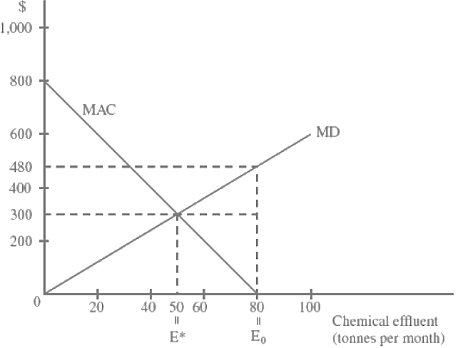
Use this graph for the analysis
Notes:
This slide shows a specific example of how a polluter achieves the socially efficient level of emission that minimizes the polluter’s total costs (=TD+TAC). This exercise are shown more detailed in the MS Excel spreadsheet posted to D2L. When you open the Excel file and first worksheet, you will see a table shown all the possible total costs for each level of emission, and also the MAC and MD functions. For example, when E=0 (if the polluter decides to totally eliminate the emission from 80 to 0), the good news would be the polluter would not need to pay any damage compensation because obviously there would be no damage because of zero emission. In this case, TD=0, but there would be a huge TAC. At E=0, MAC=800, so then the TAC would be ($800x80)/2=$32000 (the whole entire triangle under the MAC line). The other extreme case would be E=80, which means the polluter doesn’t want to spend any money on emission reduction. In this case, obviously, the polluter must pay the damage compensation, which would be equal to TD (=$480x80/2=$19200, where MD=480 at E=80), but the good news would be TAC=0. The MS Excel worksheet shows all the total costs for each level of emission, and as the table shows the polluter’s optimal (cost minimizing) level of emission would be E=50. This amount simply can be found by equating the two functions: MD=6E and MAC=800-10E. If we equate the two functions, then 6E=800-10E. After solving this equation, we will get E=50.

Slide 5
Liability Laws in Practice
In practice, transactions costs can be high preventing the socially efficient level of pollution from being reached.
A number of factors work against relying on liability to solve all environmental problems.
LO1

Slide 6
Liability Laws in Practice
Burden of proof requires injured parties to show:
That the polluting material was a direct cause of their damage, and
That the material did in fact come from the specific defendant that appears in court.
Both steps are difficult because the standards of proof required by the courts may be more than current science can supply. For example, most chemicals are implicated in increased disease only on a probabilistic basis. (E.g. smoking, air pollution -> lung disease)
Enforcement costs include:
Costs of searching out information
Costs of bargaining over terms
Costs of making sure an agreement is actually carried out.
LO1

Slide 7
Property Rights
All pollution problems involve costs to both sides:
The side that is harmed by pollution and,
The side that must pay to abate pollution
Who has the right to pollute the river and who is the damaged party?
Will assignment of rights to either party yield a socially efficient equilibrium?
These questions can be answered graphically using the chemical factory and fishery example.
LO2

Slide 8
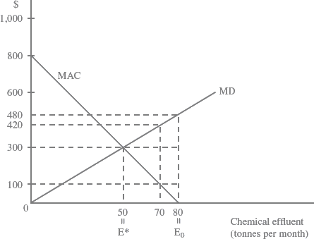
Property Rights
Assignment of Property Rights Leads to Social Efficiency Regardless of Who Has the Property Rights.
Notes:
We use the graph shown in this slide for the following two case analysis of property right assignments. The first case is considering the case where the polluter (Chemical Company) holds property rights to the river or lake. Let’s suppose that if the polluter holds the property rights to the river, then it would not have any interest to reduce the emission (chemical effluents) to the river because it is costly (which is equivalent to TAC). Here we will use the same MS Excel file, but a different worksheet (“PR-to-ChemicalCo”) in it. So then there could be a question “How can an incentive for the polluter to reduce emission be created?” The fishing farm that uses the same river (but in this case it becomes the victim of the pollution) could create an incentive by offering a payment to the polluter. Let’s suppose the fishing farm could offer the amount that equals two times of the abatement cost incurred to the polluter company. That could create an incentive for the polluter/property right holder company (Chemical company). Then there could be another very important question “How could the fishing farm benefit from this agreement? Pay to the chemical company would be a huge costs?” The fishing farm’s total benefits would be equal to how much damage could be reduced. Although the fishing farm pays offer money to the chemical company, but the total benefits (reduced damage) would be greater than the total costs (2xTAC), which is the payment to the chemical company.
The starting point for this case analysis is E=80 because this emission amount should be maximum possible emission from the polluter. If the polluter does nothing then obviously there would be no abatement cost (TAC=0), but the Total Damage (TD) for the fishing farm would be ($480x80)/2=$19,200 (which would be the maximum damage cost). Now if the polluter company starts to reduce the emission, say by 10 units, then TAC would be $100x(80-70)/2=$500, where $100 is MAC at E=70. So it means the fishing farm will offer 2*500=$1000 to the polluter company, which actually would raise their interest to reduce the emission (because they spend 500 as a TAC, but will get 1000 from the fishing farm as an offer money). How about the fishing farm? Although the fishing farm pays $1000 to the chemical company (total cost for the fishing farm), the damage reduction would be 19200-14700=4500 (total benefit for the fishing farm). Therefore, the total benefits exceed the total costs for the fishing farm, it is beneficial for the fishing farm too. All the possible net benefits for both sides can be found from the MS Excel worksheet. From the table, we find out that at E=50 both parties better off and the total net benefits are maximum ($2700 for Fishery and $4500 for Chemical company and the total becomes $7200).

Slide 9
Case 1: The Polluter Holds Property Rights
If the chemical factory has the property right to use the river, it will not abate any of its effluent. 80 tonnes per month is the starting point. To reduce chemical effluent into the river, the fishery will bargain with the chemical plant and offer a payment to the plant. Two payments are shown: $100 and $300 for the effluent reduced.
What would be the optimal level of pollution?
LO2

Slide 10
Case 2: The Pollutee Holds Property Rights
If the property right to the river belongs to the fishery the starting point will presumably be clean water; that is, zero emissions from the chemical factory. If the chemical factory wants to release any amount of effluent, it will have to bargain with and compensate the fishery.
The Optimal Point: The fishery will allow emissions as long as the payment at least covers their marginal damages. This allows the socially efficient level of pollution to be reached.
LO2
Notes:
Case #2 will analyze the opposite case, where the fishing farm holds property rights to the river/lake. In this case, the starting point would be totally clean water. In order to discharge the chemical effluent to the river the chemical company must pay the compensation to the fishing farm who holds the property rights to the river. The payment must be equal to the Marginal Damage multiplied by the corresponding level of emission (as a result, the total payment must be twice the total damage). For example, if the chemical company wants to discharge 10 tonnes of effluent, it must pay $60x10=$600 to the fishing farm, where $60 is Marginal Damage for 10th tonnes of effluent. At E=10 the total damage would be $60x10/2=$300, which would be considered as the total cost for the fishing farm. The total payment-compensation made by the chemical company would be considered as total benefit. So then at E=10 total benefits for the fishing farm would be $600, and as a result, the fishing farm is better off from this bargain. How about the chemical company? Because of the permit to discharge emission (say 10 tonnes) given by the fishing farm based on the agreement/bargain, the chemical company could save some money from the reduced TAC. The chemical company could have spend a huge amount as TAC to eliminate all the effluents (from 80 to 0), but now TAC will be spent only for 70 units emission reduction (from 80 to 10). As a result, TAC will be less, meaning that the chemical company saves money (that amount could be considered as total benefits). The maximum TAC that the Chemical company could have paid is $800x80/2=$32000. TAC for emission reduction of 70 tonnes (from 80 to 10) would be $700x(80-10)/2=$24500. The total cost saving (total benefits for the chemical company) would be 32000-24500=7500. The total costs for the chemical company would be the compensation for damages created by 10 tonnes of emission. As we calculated earlier, it is $600. As can be seen, it is very beneficial for the chemical company. This kind of process will continue until the total net benefits of two parties are maximized.

Slide 11
Property Rights
Bargaining between the two parties allows each to benefit by either receiving payment for damages or reducing their marginal abatement cost.
We see that the same equilibrium output of pollution can be obtained with either party holding the secure property right to the river.
LO2

Slide 12
Coase Theorem
Net social gains are dependent on who has the property rights to environmental resources.
The key is to clearly define property rights
Does the polluter have the right to pollute?
Or does the public have the right to a pristine environment?
This can allow for the socially efficient level of pollution to be reached, regardless of the starting point.
LO3
Notes:
According to the Coase Theorem, net social gains (which is equal to TB minus TC) are dependent on who has the property rights to environmental resources. It can be seen from the following 2 slides.

Slide 13
Group Work: Finding Net Social Gains under different Property Rights Assignments
Notes:
This slide shows the two different cases of property right assignment and shows the Coase Theorem. The next slides shows the proof of the Coase Theorem. All the small letters represent certain areas and they all have specific economic meaning. For example, the area d+e+f represents the reduced damage for the fishing farm when the chemical company reduce the emission from 80 to 50.

Slide 14
Property rights belong to the Fishery: Equilibrium at E* compared to E=0
 | Fishery | Chemical Factory
Total Damages at E=0 Total Damages at E* TAC at E=0 TAC at E* Total Payment to Fishery Net Gains | 0 c - - +(b+c) [(b+c)-c]=b | - - a+b+c+d -d -(b+c) (a+b+c)-(b+c)=a
Property rights belong to the Chemical Factory: Equilibrium at E* compared to E0
 | Fishery | Chemical Factory
Total Damages at E₀ Total Damages at E* TAC at E₀ TAC at E* Total Payment to Chemical Factory Net Gains | c+d+e+f c - - -(d+e) (d+e+f)-(d+e)=f | - - 0 d +(d+e) (d+e)-d=e
Notes:
From this table (which summarizes the two cases of property right assignment) we can see that the total net gains (=TB-TC) are dependent on who holds the property right. As can be seen from the table, when the local fishery holds property right then the total net gains (area b + a ) is greater than that (area f + e) for the case where chemical factory holds the property right.

Slide 15
Application of Property Rights
A property right should result in the efficient level of pollution but like Liability Laws, real world application introduces inefficiencies.
A property right must be clearly identifiable, known to parties, and enforceable.
It can suffer from transactions costs.
The more people involved, the more difficult it is to negotiate a solution.
LO4

Slide 16
Recycling and Green Goods
Green goods provide the same pleasure to a consumer but have a lower amount of environmental impact.
For example a paper product made from recycled paper fibers creates less pollution than virgin fibers. Other products remove pollutants such as mercury from batteries or phosphate from detergents.
If the consumer is willing to pay for the green good and substitute it for a normal product, there will be a reduction in the demand for the pollution-intensive goods, and as a result, overall pollution will decrease.
MAC curve shifts down.
LO5

Slide 17
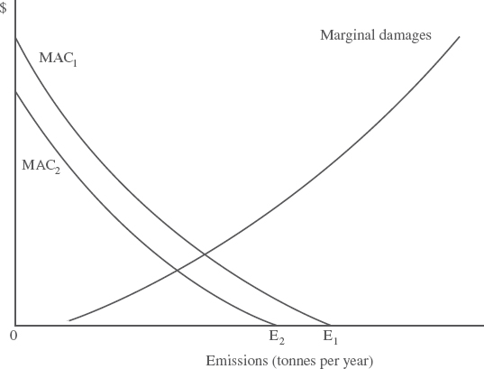
Recycling and Green Goods
Figure 10-5 How Green Goods Affect the Marginal Abatement Cost Curve
LO5

Slide 18
Let’s check what we’ve learned.
Socrative Quiz
Room: 814957

Slide 19
Chapter Overview
In this chapter, examples of decentralized approaches to environmental quality improvement were examined.
The first was to rely on liability rules, which require polluters to compensate those they have damaged.
Transaction costs preventing the socially efficient level of pollution from being reached.
Second was reliance on the institution of private-property rights.
Private bargaining and challenges associated with reaching social efficiency.
Thirdly we discussed the introduction of green goods into an economy by the private sector in response to consumer demands for less pollution intensive products.
Reduction of pollution through recycling.

